Slide 1
Tooth Discoloration: Causes, and Management
BY
SUMER MALLICK
INSTRUCTOR
SDCP

Slide 2
What is “Tooth Discoloration’’?
Tooth discoloration is defined as ‘‘any change in the hue, color, or translucency of a tooth due to any cause; restorative filling materials, drugs (both topical and systemic), pulpal necrosis, or hemorrhage may be responsible.’’

Slide 3
Most Common Discoloration
Stains on the external surfaces of teeth (referred to as extrinsic discolorations) are common and may be the result of numerous causes.

Slide 4
Tooth Discoloration in children
The color of a child's teeth can be of great importance.
Peer-group pressure can be very strong and teasing about the size, position, and color of the teeth can be very harmful for the child and adolescent.

Slide 5
Etiology
The causes of discolored teeth may be classified in a number of ways:
Congenital or acquired
Enamel or dentine
Extrinsic or intrinsic
Systemic or local

Slide 6
Extrinsic Stains Intrinsic Stains
Pulpal necrosis
Aging
Drugs (e.g. tetracycline)
Fluorosis
Amelogenesis Imperfecta
Dentinogenesis Imperfecta
Internal Resorption
Foods
Beverages
Mouth rinses
Tobacco products
Restorative materials
Chromogenic microorganisms

Slide 7
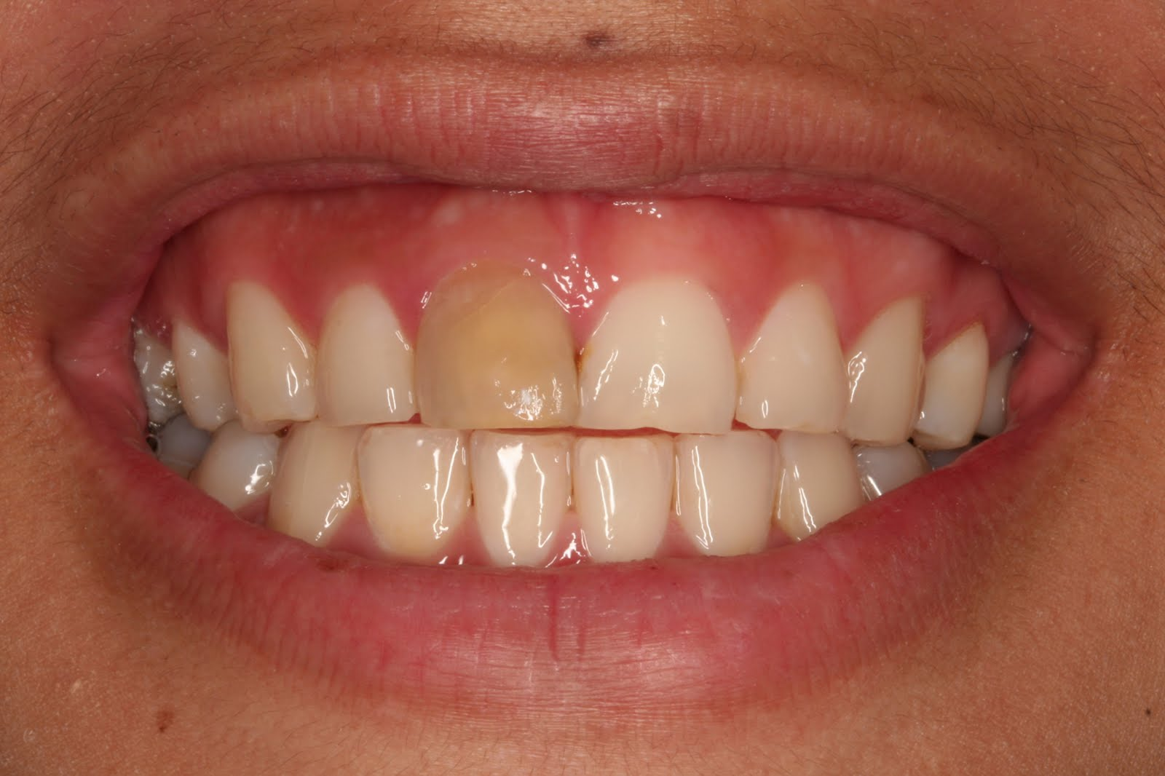
Pulp Necrosis
Pulp Necrosis: Bacterial, mechanical, or chemical irritation to the pulp may result in tissue necrosis.
Treatment: RCT followed by Intracanal bleaching (walking bleaching)

Slide 8
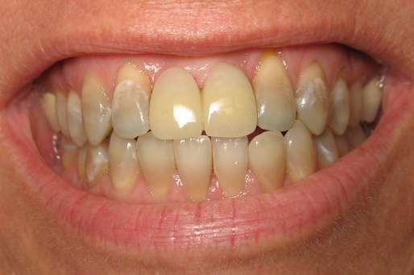
Age
Tooth color tends to become progressively darker with age, resulting from dentin apposition and thinning of the enamel.
Treatment: Extracoronal Bleaching

Slide 9
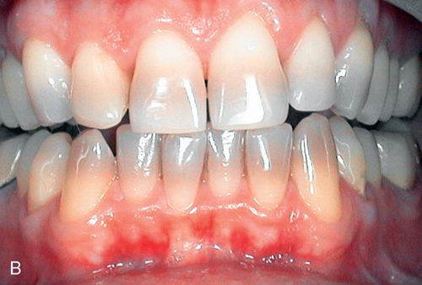
Mild Tetracycline
Treatment: External Bleaching

Slide 10
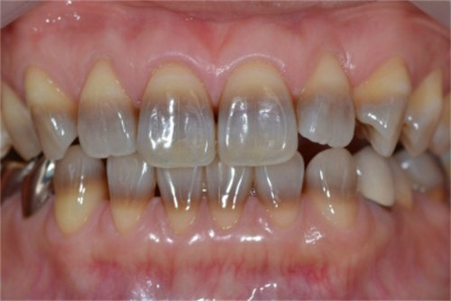
Moderate Tetracycline
Treatment: Repeated External Bleaching

Slide 11
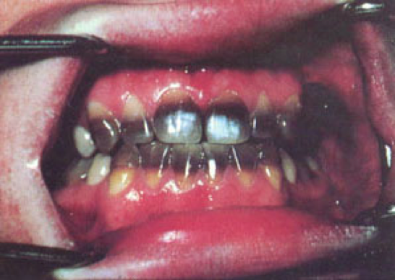
Severe Tetracycline
Treatment: Restorative, Either veneers or crown

Slide 12
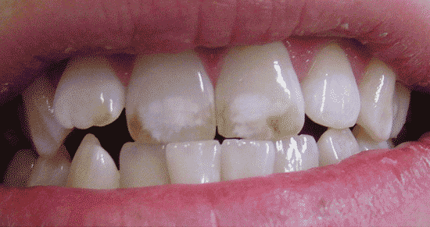
Mild Fluorosis
Treatment: Microabrasion/Macroabrasion, External Bleaching

Slide 13
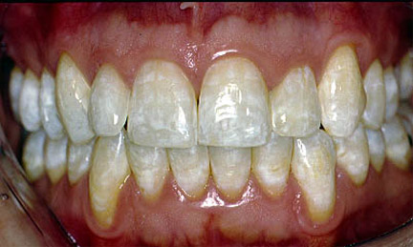
Moderate Fluorosis
Treatment: Microabrasion/Macroabrasion, External Bleaching

Slide 14
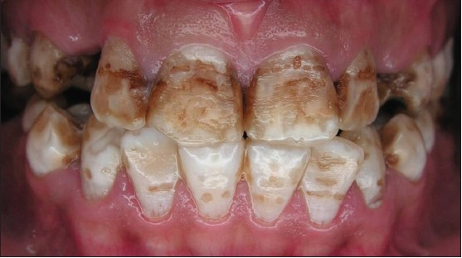
Severe Fluorosis
Treatment: Micro or Macroabrasion, Restorative (Crowns or Veneers)

Slide 15
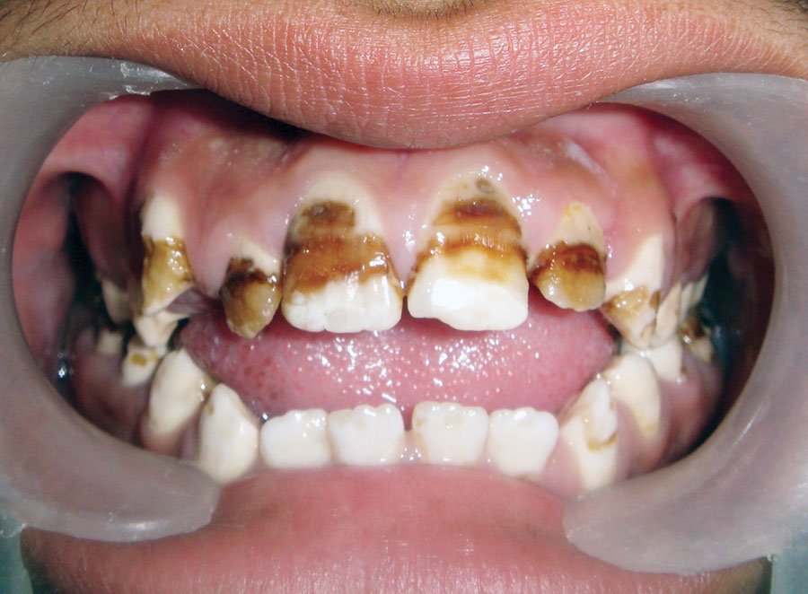
Amelogenesis Imperfecta
Treatment: Composite Veneers, Crowns or Bridges

Slide 16
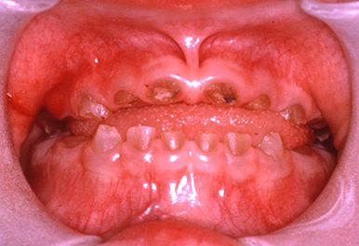
Dentinogenesis Imperfecta
A genetic disorder.
Treatment: Fillings to Veneers or Crowns and/or Bridges to Extraction, Implants or Dentures. Depending upon the age, severity and presenting complaints of the patient.

Slide 17
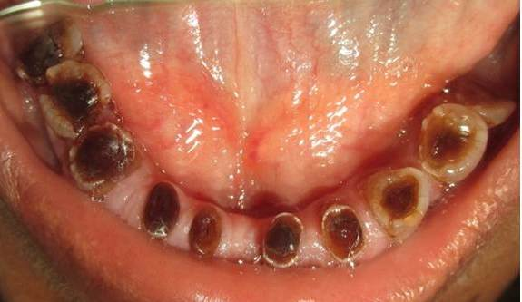
Dentinogenesis Imperfecta

Slide 18
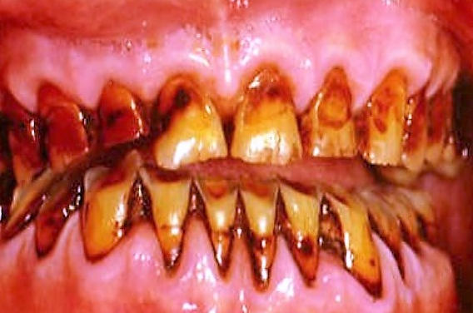
Tobacco Discoloration
Nicotine can discolor teeth.
Treatment: Extracoronal Bleaching

Slide 19
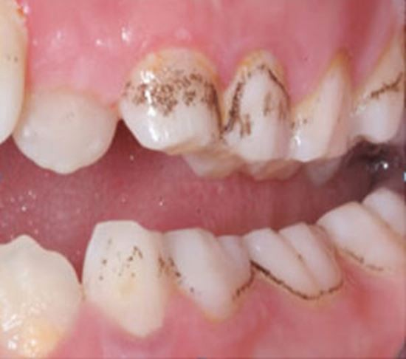
Chromogenic Bacteria
Treatment: Scaling and Polishing

Slide 20
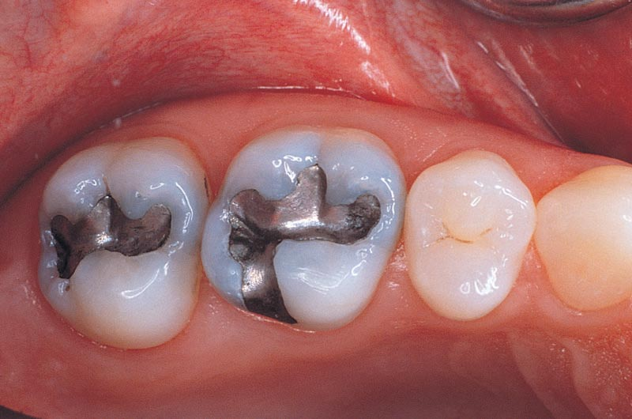
Discoloration due to Amalgam Restoration
Treatment: replacing the amalgam with an esthetic restoration.

Slide 21
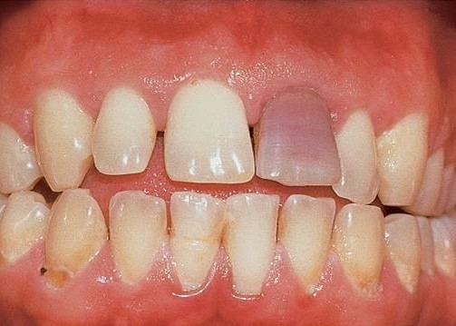
Internal Root Resorption
Typical Pink color discoloration
Treatment: Root Canal Treatment followed by intracanal bleaching if necessary

Slide 22
Chemical techniques for treatment of tooth discoloration.
It includes:
Micro-abrasion.
Office bleaching using self, light or heat activated.
Patient administered home bleaching using carbamide peroxide gels.

Slide 23
MICROABRASION
A procedure in which an abrasive compound (pumice) mixed with Hydrochloric acid is applied to the surface of teeth to remove a small amount of dental tissue.

Slide 24
MICROABRASION TECHNIQUE
Controlled method of removing surface enamel
To improve discoloration limited to outer enamel layer.
It is achieved by a combination of abrasion and erosion ⎯ the term 'abrosion' is sometimes used.

Slide 25
Microabrasion technique
No more than 100 um of enamel are removed
Too much enamel removal is potentially damaging to the pulp
And cosmetically the underlying dentine colour will become more evident.

Slide 26
Indications
1) Fluorosis
2) Idiopathic speckling
3) Postorthodontic treatment demineralization
4) Prior to veneer placement for well-demarcated stains
5) White/brown surface staining, e.g. secondary to primary predecessor infection or trauma (Turner teeth)

Slide 27
Micro clean kit for extrinsic stain.
It consists of
1- 10% hydrogen peroxide gel.
2- Dilute hydrochloric acid gel.
3- Concentrated hydrochloric acid gel.
4- Neutralizing gel.
5- Polishing paste containing fluoride.

Slide 28
Technique for extrinsic stains
Gingiva are well protected before microabrasion.
Mixture consisting of dilute hydrochloric acid, 10% hydrogen peroxide and abrasive is used.
It is applied with rubber cup for 5 sec at a time followed by rinsing with water.
Sodium bicarbonate gel is then applied to gingiva and teeth to neutralize the acid action.
Micro abrasion is always followed by polishing of teeth with fluoride containing paste.

Slide 29
Microabrasion for Intrinsic stain
Armamentarium
Rubber Dam
18 % Hydrochloric Acid (HCl)
Pumice Powder
Bicarbonate of soda/water
Rubber Prophylaxis cup
Fluoride drops
Fluoridated Toothpaste
Soflex Discs (3M)

Slide 30
Technique for Intrinsic stains
Vitality tests, radiographs and photographs
Clean, with pumice and water, wash, and dry.
3. Isolate the teeth with rubber dam.
Place a mixture of sodium bicarbonate and water on the dam behind the teeth, as protection in case of spillage.

Slide 31
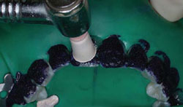
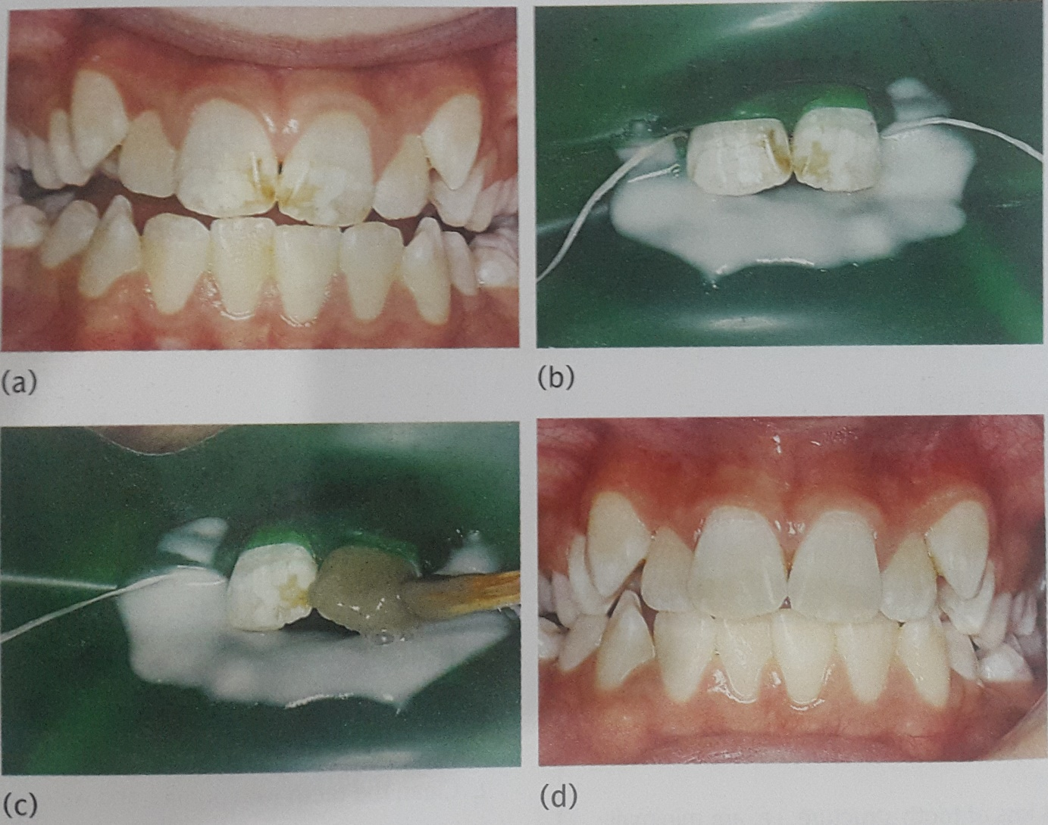
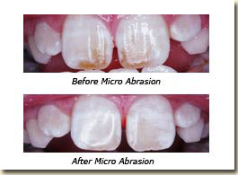

Slide 32
Technique
5. Mix 18% hydrochloric acid with pumice into a slurry and apply on
labial surface of teeth with rubber cup rotating for 5 sec.
6. Wash for 5 sec.
7. Repeat until stain are reduce upto maximum of 10 times.
8. Apply the fluoride drops to the teeth for 3 min
9. Remove the rubber dam
10. Polish the teeth with the finest Soflex discs.
11. Polish the teeth with fluoridated toothpaste for 1 min
12. Review in 1 month for vitality tests and clinical photographs
13. Review biannually checking pulpal status

Slide 33
Macroabrasion
An alternative technique for the removal of localized, superficial white spots and other surface stains or defects is called macroabrasion.

Slide 34
Macroabrasion
The macroabrasion procedures should be placed as a conservative option in the treatment of white lesions in the anterior teeth. With a conservative procedure, and using a simple restorative technique we can restore the natural aesthetics to the affected teeth.

Slide 35
Macroabrasion – Clinical Technique
It simply uses a fine grit finishing diamond bur in a high speed handpiece with adequate air-water spray to remove the defect.
Care must be taken to use light, intermittent pressure and to monitor the removal of tooth structure carefully to avoid irreversible damage to tooth.

Slide 36
Non-vital bleaching / Walking Bleach
This technique describes the bleaching of teeth that have become discoloured by the diffusion into the dentinal tubules of haemoglobin breakdown products from necrotic pulp tissue.

Slide 37
Non-vital bleaching / Walking Bleach
Indications:
1) Discoloured non-vital teeth
2) Well-condensed gutta percha root filling
3) No clinical or radiological signs of periapical disease.

Slide 38
Non-vital bleaching / Walking Bleach
Armamentarium
Rubber dam
Zinc phosphate or IRM cement
37% phosphoric acid
Bleaching agent, for example, hydrogen peroxide, carbamide peroxide, or sodium perborate.

Slide 39
Non-vital bleaching / Walking Bleach
Armamentarium
5. Cotton wool
6. Glass ionomer cement
7. Composite resin
8. Non-setting calcium hydroxide

Slide 40
Non-vital bleaching / Walking Bleach
Technique
Take preoperative periapical radiographs; these are essential to check for an adequate root filling
Clean the teeth with pumice and make a note of the shade of the discoloured tooth
Place rubber dam, isolating the single tooth. Ensure adequate eye and clothing protection for the patient, operator, and dental nurse.

Slide 41
4. Removal palatal and pulp chamber restoration.
5. Remove root filling to the level of dentinogingival junction.
6. Place RMGIC of 2mm thickness over GP.
7. Etch the pulp chamber with 37% phosphoric acid for 30-60 seconds, wash, and dry ⎯ this will facilitate the ingress of the hydrogen peroxide

Slide 42
Non-vital bleaching / Walking Bleach
8. Place the bleaching agent Sodium Perborate ⎯ either mixed with water or hydrogen peroxide ⎯ into the pulp chamber.
9. Place a dry piece of cotton wool over the mixture.
10. Seal the cavity with glass ionomer cement.

Slide 43
Non-vital bleaching / Walking Bleach
11. Repeat the process at weekly intervals until the tooth is slightly overbleached.
12. Place non-setting calcium hydroxide into the pulp chamber for 2 weeks. Seal with glass ionomer cement.

Slide 44
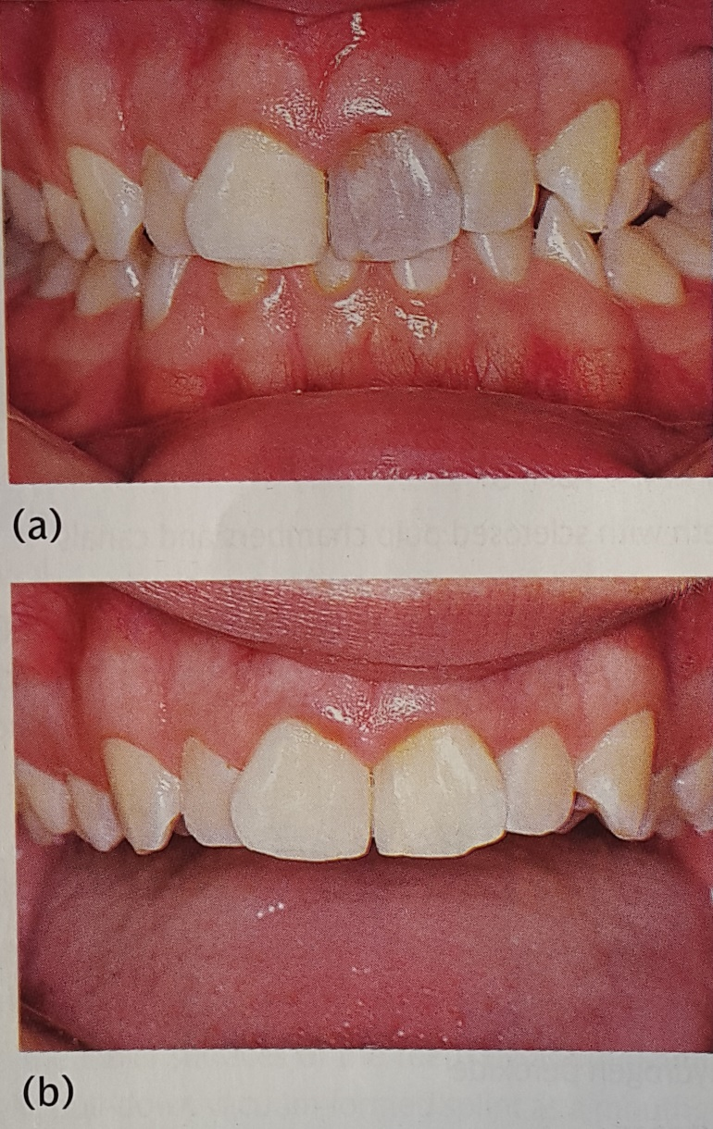

Slide 45
Vital Bleaching ⎯ At office
Indications:
Very mild tetracycline staining without obvious banding.
Mild fluorosis
Yellowing due to ageing
Single teeth with sclerosed pulp chambers and canals

Slide 46
Vital Bleaching ⎯ In office
This technique involves the external application of 35 to 40 % Hydrogen Peroxide to the surface of the tooth followed by its activation with a heat source
it is a lengthy and time-consuming procedure
requires a high degree of patient compliance and motivation.

Slide 47
Vital bleaching ⎯ At home
This technique involves the daily placement of carbamide peroxide gel into a custom fitted tray of either the upper or the lower arch.
As the name suggests, it is carried out by the patient at home and is initially done on a daily basis.

Slide 48
Vital bleaching ⎯ At home
Indications:
mild fluorosis
moderate fluorosis as an adjunct to hydrochloric acid-pumice microabrasion
yellowing of ageing

Slide 49
Vital bleaching ⎯ At home
Carbamide peroxide gel (10%) breaks down in the mouth into 3% hydrogen peroxide and 7% urea. Both urea and hydrogen peroxide have low molecular weights, which allow them to diffuse rapidly through enamel and dentine and thus explains the transient pulpal sensitivity occasionally experienced with home bleaching systems.

Slide 50
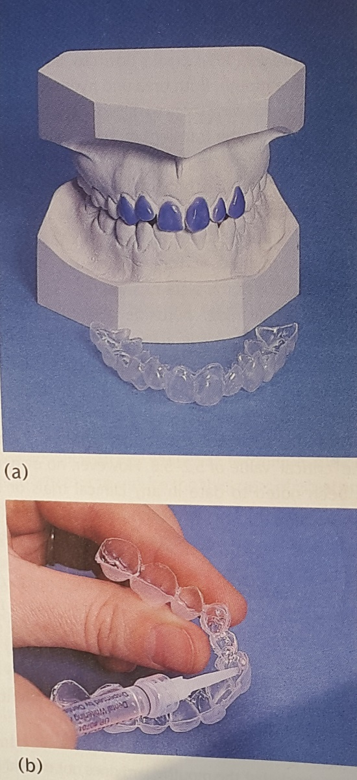

Slide 51
Localized composite resin restorations
Indications:
1. Well-demarcated white, yellow, or brown hypomineralised enamel.

